Slide 1
PLAYERS & TEAM PERFORMANCE ANALYSIS

Slide 2

project is a comprehensive data analysis initiative aimed at evaluating the on-field performance of football players and teams
01
Description
Detailed analysis of individual player and Teams performance (goals, assists, ratings)
02
To evaluate player and team performance through advanced SQL techniques and uncover actionable insights for improving strategy, selection, and management.
03
It focuses on identifying top performers, team strengths and weaknesses, and overall league dynamics using both descriptive and analytical techniques.
04

Slide 3
TABLES
Players Table
Teams Table
Matches Table
Competitions Table
PlayerPerformance Table
PlayerContracts Table
PlayerFitness Table

Slide 4
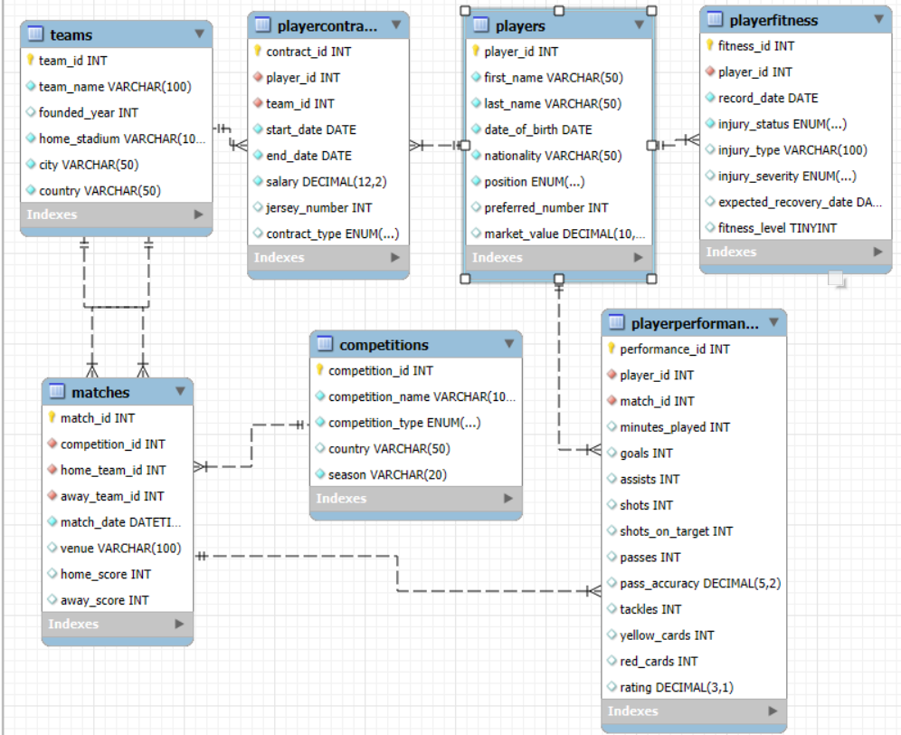
ER Diagram

Slide 5
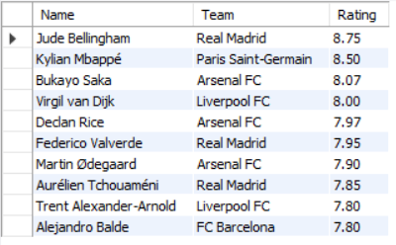
1. Find Top 10 Players based on Rating
select concat(P.first_name," ",P.last_name) as Name,T.team_name as Team,
round(avg(PP.rating),2) as Rating from Players P
join PlayerPerformance PP on P.player_id = PP.player_id
join PlayerContracts PC on P.player_id = PC.player_id
join Teams T on PC.team_id = T.team_id
group by PP.player_id,T.team_name order by Rating desc limit 10;

Slide 6
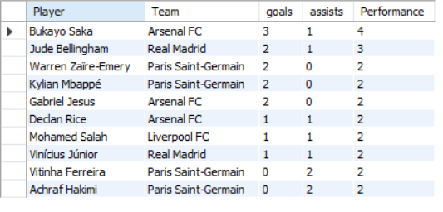
2. Find Top 10 Player based on Goals + Assists
select concat(P.first_name," ",P.last_name) as Player,T.team_name as Team,
sum(PP.goals) as goals ,sum(PP.assists) as assists,sum(goals) + sum(assists) as Performance
from PlayerPerformance PP join Players P on P.player_id = PP.player_id
join PlayerContracts PC on P.player_id = PC.player_id
join Teams T on PC.team_id = T.team_id
group by P.player_id , T.team_name order by Performance desc , goals desc limit 10;

Slide 7
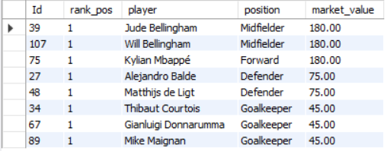
3. Find Most Valued Player Based on playing position
select Id,rank_pos , player , position, market_value
from ( select player_id as Id,CONCAT(first_name, ' ', last_name) AS player , position , market_value ,
dense_rank() over (partition by position order by market_value desc) as rank_pos from Players )
as ranked
where rank_pos = 1order by market_value desc;

Slide 8
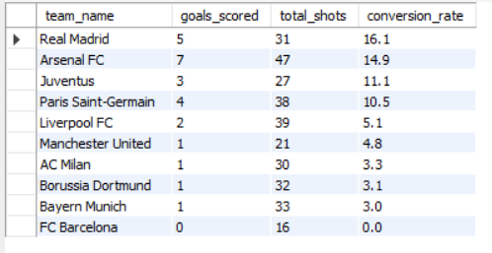
4. Find Team Effectiveness (conversion_rate)
select t.team_name , sum(pp.goals) as goals_scored , sum(pp.shots) as total_shots ,
round(sum(pp.goals)/sum(pp.shots)*100, 1) as conversion_rate
from PlayerPerformance pp join PlayerContracts pc on pp.player_id = pc.player_id
join Teams t on pc.team_id = t.team_id
group by t.team_id order by conversion_rate desc;

Slide 9
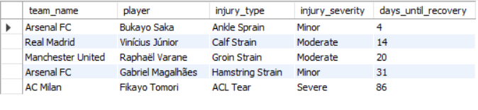
5. Create Injury report of Teams
select t.team_name , concat(p.first_name, ' ', p.last_name) as player, pf.injury_type , pf.injury_severity ,
datediff( pf.expected_recovery_date,curdate()) as days_until_recovery
from PlayerFitness pf
join Players p on pf.player_id = p.player_id
join PlayerContracts pc on p.player_id = pc.player_id
join Teams t on pc.team_id = t.team_id
where pf.injury_status != 'Fit'order by days_until_recovery;

Slide 10
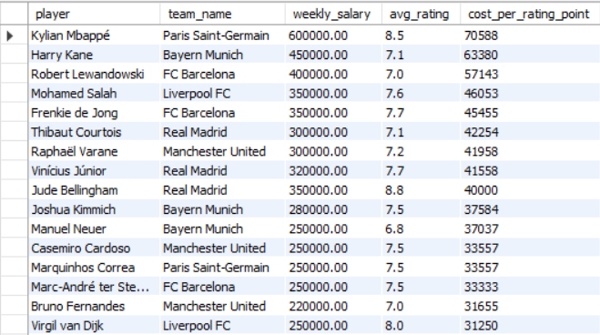
6. Find Salary Vs Performance Analysis
select concat(p.first_name, ' ', p.last_name) as player , t.team_name , pc.salary as weekly_salary ,
round(avg(pp.rating), 1) as avg_rating , round(pc.salary / avg(pp.rating), 0) as cost_per_rating_point
from PlayerContracts pc join Players p on pc.player_id = p.player_id
join PlayerPerformance pp on p.player_id = pp.player_id
join Teams t on pc.team_id = t.team_id
group by p.player_id, t.team_name, pc.salary
having count(pp.match_id) > 0 order by cost_per_rating_point desc;

Slide 11
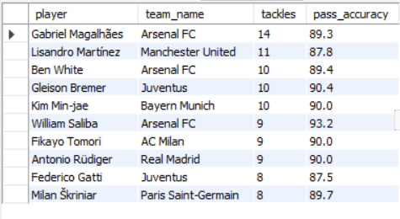
7. Find Top 10 Defenders
select concat(p.first_name, ' ', p.last_name) as player , t.team_name , sum(pp.tackles) as tackles ,
round(avg(pp.pass_accuracy), 1) as pass_accuracy
from PlayerPerformance pp join Players p on pp.player_id = p.player_id
join PlayerContracts pc on p.player_id = pc.player_id
join Teams t on pc.team_id = t.team_id
where p.position = 'Defender’ group by p.player_id order by tackles descl imit 10;

Slide 12
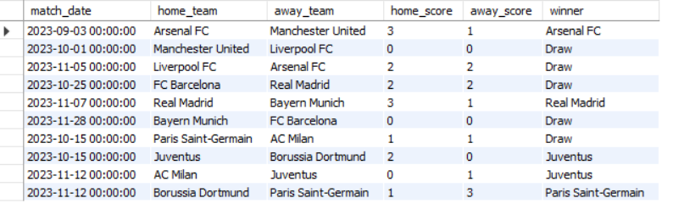
8. Create Match Summary
select m.match_date , ht.team_name as home_team , at.team_name as away_team , m.home_score ,
m.away_score,
case when m.home_score > m.away_score then ht.team_name
when m.away_score > m.home_score then at.team_name
else 'Draw'end as winnerfrom Matches m
join Teams ht on m.home_team_id = ht.team_id
join Teams at on m.away_team_id = at.team_id;

Slide 13
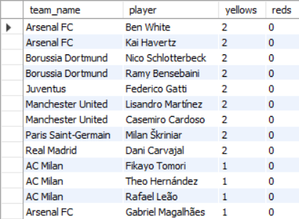
9. Find Player with most yellow and red cards
Select t.team_name , concat(p.first_name, ' ', p.last_name) as player , sum(pp.yellow_cards) as yellows,
sum(pp.red_cards) as reds
from PlayerPerformance pp join Players p on pp.player_id = p.player_id
join PlayerContracts pc on p.player_id = pc.player_id
join Teams t on pc.team_id = t.team_id
group by p.player_id having (yellows + reds) > 0 order by (yellows + reds) desc;

Slide 14
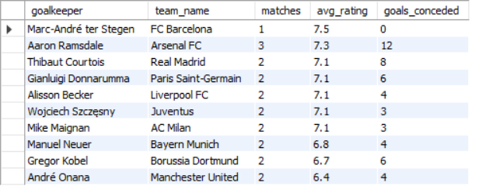
10. Goalkeeper Analysis
select concat(p.first_name, ' ', p.last_name) as goalkeeper , t.team_name ,
count(distinct m.match_id) as matches , round(avg(pp.rating), 1) as avg_rating ,
sum(m.home_score + m.away_score) as goals_conceded
from PlayerPerformance pp join Players p on pp.player_id = p.player_id
join Matches m on pp.match_id = m.match_id
join PlayerContracts pc on p.player_id = pc.player_id
join Teams t on pc.team_id = t.team_id
where p.position = 'Goalkeeper’ group by p.player_id order by avg_rating desc , goals_conceded desc;

Slide 15
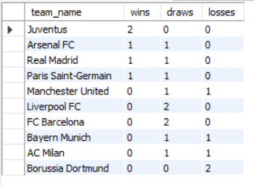
11. Create Team Result Report
select team_name , sum(case when result = 'Win' then 1 else 0 end) as wins ,
sum(case when result = 'Draw' then 1 else 0 end) as draws , sum(case when result = 'Loss' then 1 else 0 end) as losses
from ( select ht.team_name , case when m.home_score > m.away_score then 'Win’
when m.home_score < m.away_score then 'Loss’ else 'Draw’ end as result
from Matches m join Teams ht ON m.home_team_id = ht.team_id
union all
select at.team_name , case when m.away_score > m.home_score then 'Win’
when m.away_score < m.home_score then 'Loss’ else 'Draw'end as result
from Matches m join Teams at on m.away_team_id = at.team_id) as team_results
group by team_name order by wins desc;

Slide 16
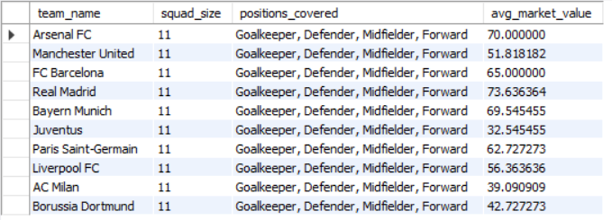
12. Team Squad Analysis
select t.team_name , count(distinct p.player_id) as squad_size,
Group_concat(distinct p.position separator ', ') as positions_covered,
avg(p.market_value) as avg_market_value
from Players p join PlayerContracts pc on p.player_id = pc.player_id
join Teams t on pc.team_id = t.team_id
group by t.team_id order by squad_size desc;

Slide 17
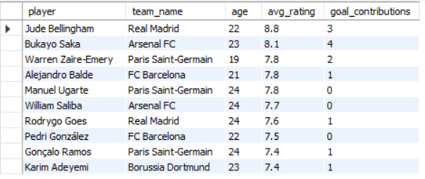
13. Find Top Young Talent
select concat(p.first_name, ' ', p.last_name) as player, t.team_name ,
timestampdiff(year, p.date_of_birth, curdate()) as ag , round(avg(pp.rating), 1) as avg_rating ,
sum(pp.goals + pp.assists) as goal_contributions
from Players p join PlayerPerformance pp on p.player_id = pp.player_id
join PlayerContracts pc on p.player_id = pc.player_id
join Teams t on pc.team_id = t.team_id
where p.date_of_birth > date_sub(curdate(), interval 25 year)
group by p.player_id having count(pp.match_id) > 0 order by avg_rating desc , goal_contributions desc limit 10;

Slide 18
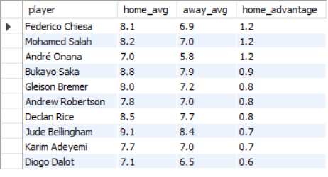
14. Find Team gaining most from home advantage
SELECT player , home_avg , away_avg , home_avg - away_avg AS home_advantage
from (select concat(p.first_name, ' ', p.last_name) as player ,
round(avg(case when m.home_team_id = pc.team_id then pp.rating end), 1) as home_avg ,
round(avg(case when m.away_team_id = pc.team_id then pp.rating end), 1) as away_avg
from PlayerPerformance pp join Players p on pp.player_id = p.player_id
join Matches m on pp.match_id = m.match_id
join PlayerContracts pc on p.player_id = pc.player_id
group by p.player_idhaving count(distinct case when m.home_team_id = pc.team_id then pp.match_id end) > 0 and count(distinct case when m.away_team_id = pc.team_id then pp.match_id end) > 0) as home_away order by home_advantage desc limit 10;

Slide 19
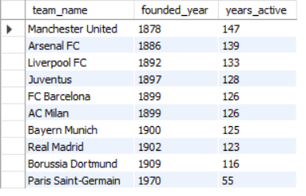
15. Find active years for all Teams
select team_name , founded_year , timestampdiff(year, concat(founded_year, '-01-01’) ,
curdate()) as years_active
from Teams order by years_active desc;

Slide 20
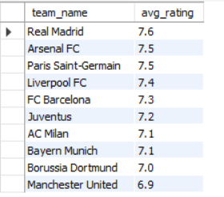
16. Find average Teams (all Players) rating
select t.team_name, ROUND(avg(pp.rating), 1) as avg_rating
from PlayerPerformance pp join PlayerContracts pc on pp.player_id = pc.player_id
join Teams t on pc.team_id = t.team_id
group by t.team_name order by avg_rating desc;

Slide 21
17. Find No of Players in Team of same nationality
select nationality, count(*) as player_count
from Players
group by nationality
order by player_count desc;

Slide 22
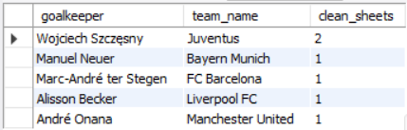
18. Find Cleansheets for Goalkeeper
select concat(p.first_name, ' ', p.last_name) as goalkeeper , t.team_name , count(*) as clean_sheets
from PlayerPerformance pp
join Players p on pp.player_id = p.player_id
join Matches m on pp.match_id = m.match_id
join PlayerContracts pc on p.player_id = pc.player_id
join Teams t on pc.team_id = t.team_id
where p.position = 'Goalkeeper’ and ((m.home_team_id = t.team_id and m.away_score = 0)
or (m.away_team_id = t.team_id and m.home_score = 0))
group by goalkeeper order by clean_sheets desc;

Slide 23
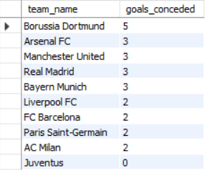
19. Find Teams which conceded most goal
select t.team_name ,
sum(case when m.home_team_id = t.team_id then m.away_score else m.home_score end) as goals_conceded
from Matches m join Teams t on t.team_id in (m.home_team_id, m.away_team_id)
group by t.team_name order by goals_conceded desc;

Slide 24
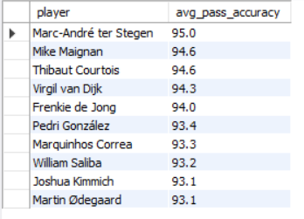
20. Find Players highest pass accuracy
select concat(first_name, ' ', last_name) as player , round(avg(pass_accuracy), 1) as avg_pass_accuracy
from PlayerPerformance pp join Players p on pp.player_id = p.player_id
where passes > 20 group by player order by avg_pass_accuracy desc limit 10;

Slide 25
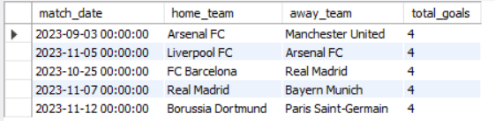
21. Find high scoring Matches
select m.match_date, ht.team_name as home_team , at.team_name as away_team ,
m.home_score + m.away_score as total_goals
from Matches m join Teams ht on m.home_team_id = ht.team_id
join Teams at on m.away_team_id = at.team_id
order by total_goals desc limit 5;

Slide 26

22. Find average goals per Match
SELECT ROUND(AVG(home_score + away_score), 1) AS avg_goals_per_matchFROM Matches

Slide 27
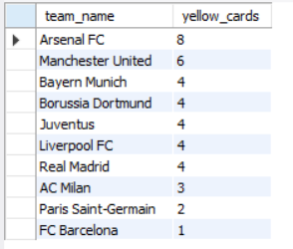
23. Find Teams Conceding most Yellow cards
select t.team_name, SUM(pp.yellow_cards) AS yellow_cards
from PlayerPerformance pp join PlayerContracts pc on pp.player_id = pc.player_id
join Teams t on pc.team_id = t.team_id
group by t.team_name order by yellow_cards desc;

Slide 28
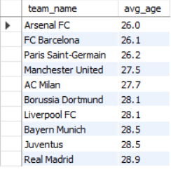
24. Find Average Team Player Age
select t.team_name, round(avg(timestampdiff(year, p.date_of_birth, CURDATE())), 1) as avg_age
from Players p join PlayerContracts pc on p.player_id = pc.player_id
join Teams t on pc.team_id = t.team_id group by t.team_name order by avg_age;

Slide 29
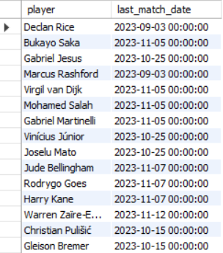
25. Find Players who scored in their last match
select concat(p.first_name, ' ', p.last_name) as player , max(m.match_date) as last_match_date
from PlayerPerformance pp join Players p on pp.player_id = p.player_id
join Matches m on pp.match_id = m.match_id
where pp.goals > 0 group by player;

Slide 30
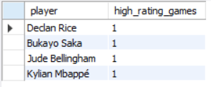
26. Find Players with Most Man of the Match (High Ratings)
select concat(first_name, ' ', last_name) as player , count(*) as high_rating_games
from PlayerPerformance pp
join Players p on pp.player_id = p.player_id
where rating >= 8.5 group by player order by high_rating_games desc limit 10;

Slide 31
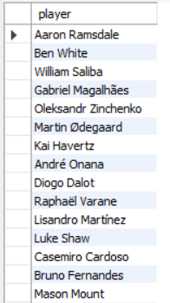
27. Find Players who never scored
select concat(first_name, ' ', last_name) as player
from Players p
where not exists (select 1 from PlayerPerformance pp where pp.player_id = p.player_id and goals > 0);

Slide 32
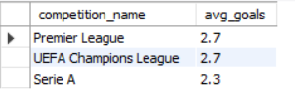
28. Find average goals per competition
select c.competition_name , round(avg(home_score + away_score), 1) as avg_goals
from Matches m join Competitions c on m.competition_id = c.competition_id
group by c.competition_name order by avg_goals desc;

Slide 33

29. Find wins by Goal Margins
select abs(home_score - away_score) as goal_margin , count(*) as matches
from Matches
where home_score != away_score group by goal_margin order by matches desc;

Slide 34
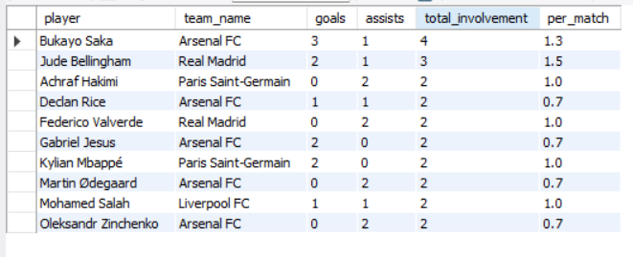
30. Find Players involved in most goals
select concat(p.first_name, ' ', p.last_name) as player , t.team_name , sum(pp.goals) as goals,
sum(pp.assists) as assists , sum(pp.goals) + sum(pp.assists) as total_involvement ,
round((sum(pp.goals) + sum(pp.assists)) / count(distinct pp.match_id), 1) as per_match
from PlayerPerformance pp join Players p on pp.player_id = p.player_id
join PlayerContracts pc on p.player_id = pc.player_id
join Teams t on pc.team_id = t.team_id
group by player having count(distinct pp.match_id) > 0 order by total_involvement desc limit 10;

Slide 35
THANK YOU

